Slide 1
An OSGi Based SaaS Architecture that Supports Code Level Customization
CHEN, Xiao Yu 15855860
LI, Mao Chuan 14854389
Chandan Sharma 14885271

Slide 2
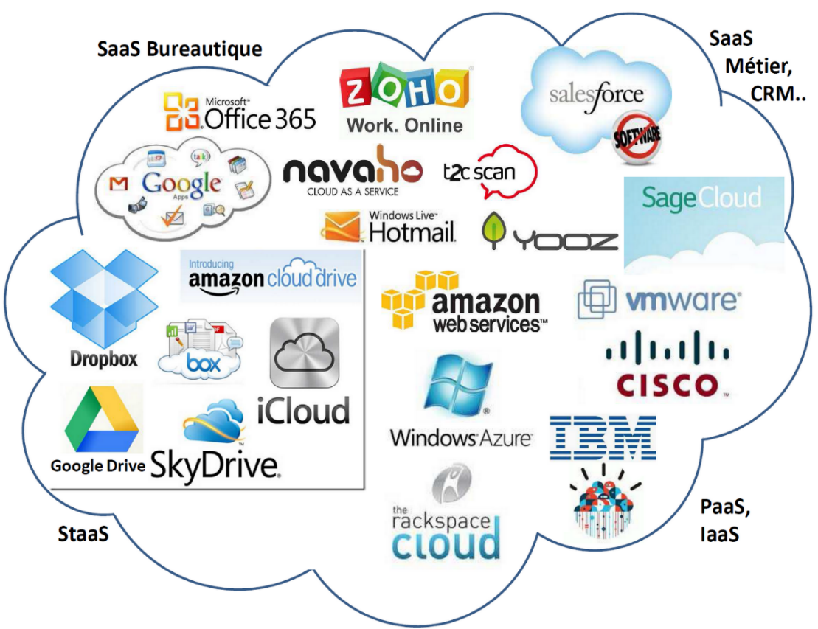
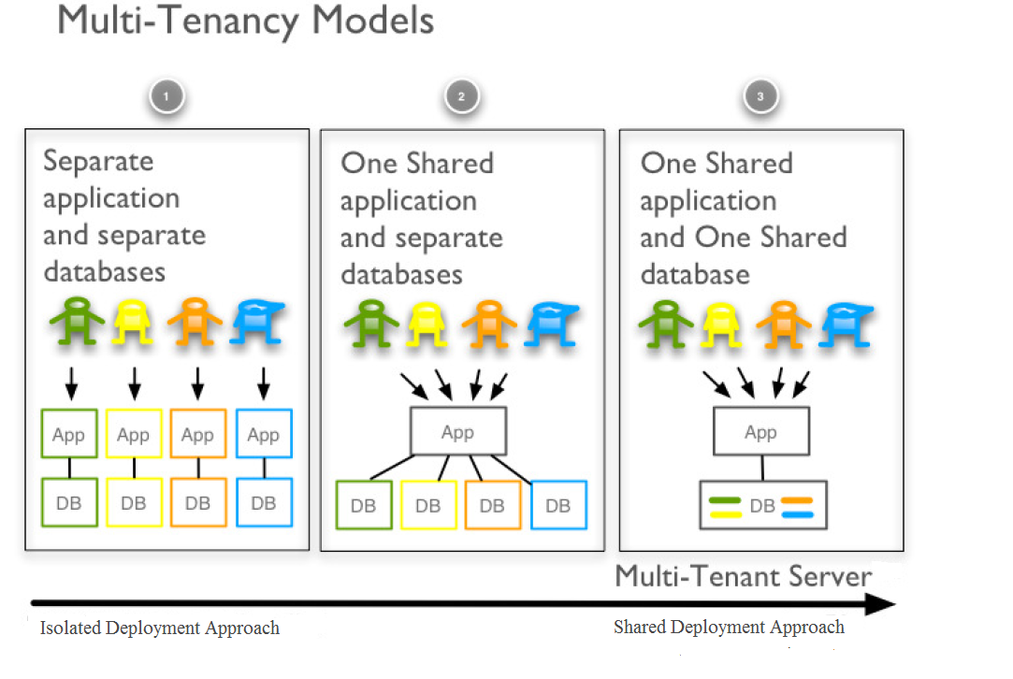
SAAS at a glance

Slide 3
configurability
User Interface
Workflow
Data
Access Control
We propose a fifth level of configuration. “CODE”
Tenants can develop add-on’s and integrate them with the system to fulfil the requirements.

Slide 4

EFFECTS
Security is the major concern.
Create a novel architecture that enables CODE level extension.

